Slide 1
Application Of Graph Theory in Deep Learning
By:
Tejas Hegde
1MS20CS129
Department Of CSE

Slide 2
What is Deep Learning?
Deep learning is an AI technique that attempts to simulate the behavior of the human brain by trying to “learn” from large amounts of data.
Deep learning drives many artificial intelligence (AI) applications and services that improve automation, performing analytical and physical tasks without human intervention. Deep learning technology lies behind everyday products and services (such as digital assistants, voice-enabled TV remotes, and credit card fraud detection) as well as emerging technologies (such as self-driving cars).

Slide 3
What is AI? What is “learning”?
In general, artificial intelligence is the field of science devoted to making computers perceive, reason, and act in ways that have, until now, been reserved for human beings.
Whereas - measure against an ideal performance measure, called rationality. A system is rational if it does the “right thing,” given what it knows
Learning is said to take place if a computer improves its performance as suggested by the performance measure with experience.
For example by “analyzing” a lot of credit card transactions to find which ones are fraudulent, a computer will then classify new credit card transactions as fraudulent or non fraudulent.

Slide 4
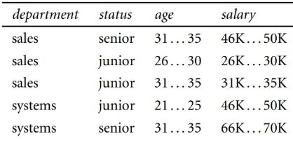
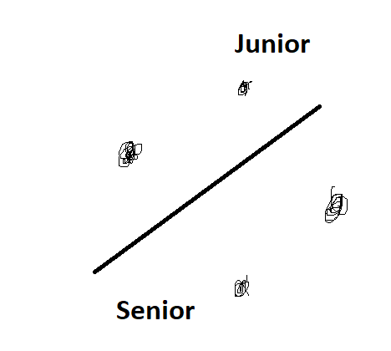
“Analyzing”
The computer first requires data. Data can be in any form for e.g. Text, audio, video, images, logs and so on. Here, it is given to it in a tabular form.
Every column represents an attribute of an object. In this case, it tells the properties of an employee. For e.g., the department of an employee is sales, status is senior, age lies in 31-35 and salary lies in 46K-50K.
We need to define the task at hand: To determine status given department, age and salary if the employee. This task is known as classification.
The computer uses every row of the table in its analysis. The procedure can be described in various ways. For e.g.,:
If department=sales, age=31-35,salary=46-50K then status=senior (or)
The points above the line represent employees who are junior. Those below represent those who are senior. Line=Hyperplane
And then, it uses these rules(or the hyperplane) to automatically assign new datapoints to a class. For e.g., the computer may tell that since Ram’s department is sales, age=26-30, salary=26-30K he is a junior employee.
What if, we give department=sales, age=31-35, salary=26-30K what would it be classified as? The computer will give an answer which may or may not be correct. Thus, in order to check how well our computer learns, we need a measure. This measure if viewed negatively is called loss(deviation) and called accuracy(similarity) if viewed positively.

Slide 5
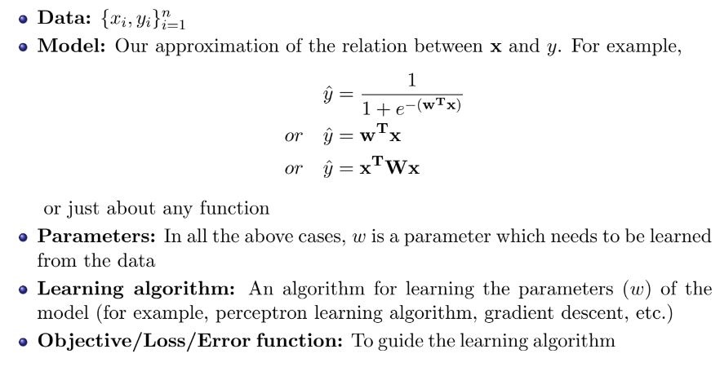
Learning
The previously stated methodology of analysis of data to automatically perform a task is known as machine learning.
In general, any machine learning task can be summarized in terms of the following things:

Slide 6
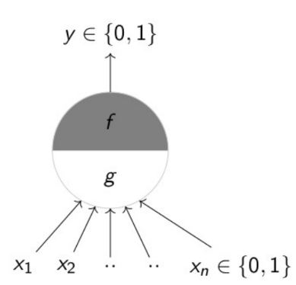
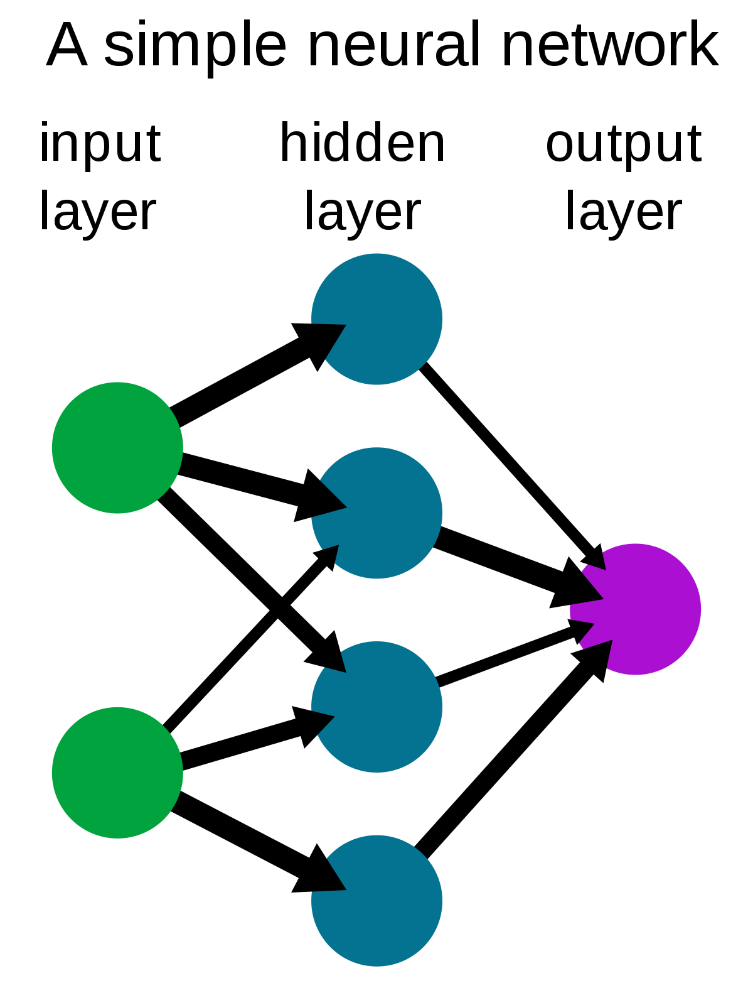
How Deep Learning Works
As said earlier, deep learning simulates a human brain. The fundamental unit of the nervous system is the neuron. Similar to the biological neuron, we have the artificial neuron. We have the inputs x₁,x₂,…,x_{n} which are aggregated using the function g and then the function f applies a decision function to the aggregated value. Usually, g is called preactivation and g is called activation.
A single neuron does not have sufficient power to classify complex data. Hence we go for a network of neurons, similar to what our brain might be like. Hence we name such a network as artificial neural network.
Generally any neural network has three kinds of layers: input layer, hidden layer and the output layers. While the input and output layers are obvious, the hidden layer is used in order to learn complex classification functions. In fact, we have the universal approximation theorem which states that a multilayer network of neurons with a single hidden layer can be used to approximate any continuous function to any desired precision.
We can have any number of hidden layers.

Slide 7
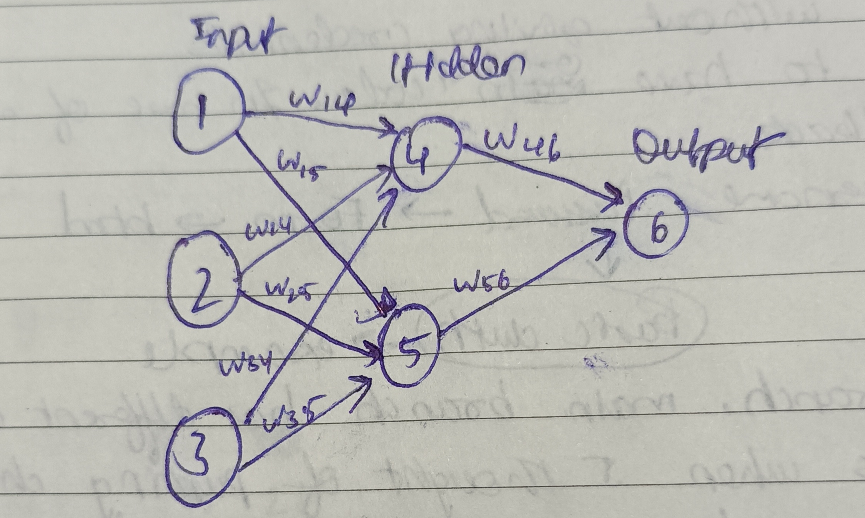
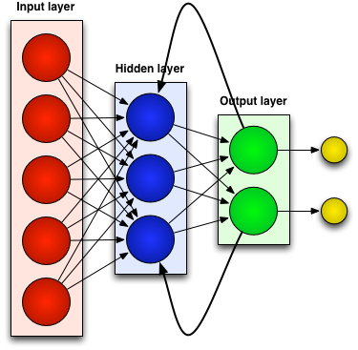
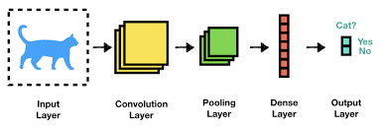
Where is the learning?
Here too we need to learn the weights(i.e. parameters).
Notice that the neural network is a complete bipartite graph.
There is a weight for every edge.
To learn these weights we have to use the loss/objective/error function and an algorithm such as the backpropagation algorithm.
This is just one kind of and the simplest of neural networks. There are several other kind of neural networks such as Convolutional Neural Networks(widely used in Image Processing), Recurrent Neural Networks(for language translation), LSTM(Long Short Term Memory, used in time series data).
Each type of NN has its own way of “learning”.

Slide 8
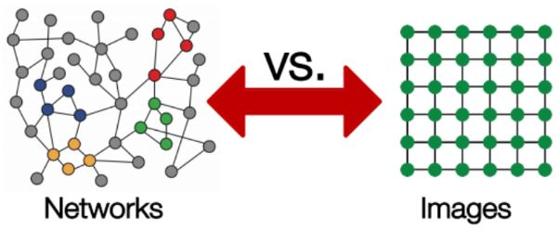
Graph Neural Network
Now what if we tried to use traditional neural networks for graphs?
The tweets made on Twitter is an example of graph data. Suppose we want to predict which tweets on Twitter are from bots, and which are from organic users. How would we achieve that?
It’s difficult to apply neural networks such as a CNN on graphs because CNNs expect simple sequence of grids(an image is a matrix of pixels), but networks often have complex topographical structures.

Slide 9
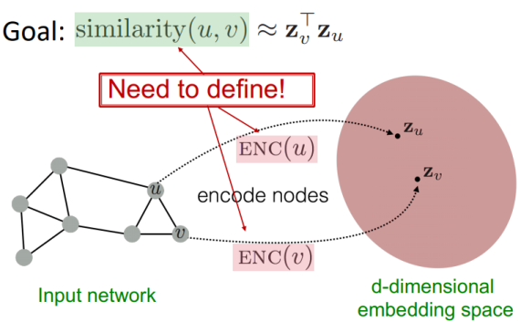
GNN
In graph theory, we implement the concept of Node Embedding. It means mapping nodes to a d- dimensional embedding space (low dimensional space rather than the actual dimension of the graph), so that similar nodes in the graph are embedded close to each other.
Our goal is to map nodes so that similarity in the embedding space approximates similarity in the network. Here we use the GraphSage algorithm.
Let’s define u and v as two nodes in a graph.
x_{u} and x_{v} are two feature vectors.
Now we’ll define the encoder function Enc(u) and Enc(v), which convert the feature vectors to z_{u} and z_{v}.
Note: the similarity function could be Euclidean distance.
The encoder function should be able to perform :
Locality (local network neighborhoods)
Aggregate information
Stacking multiple layers (computation)

Slide 10
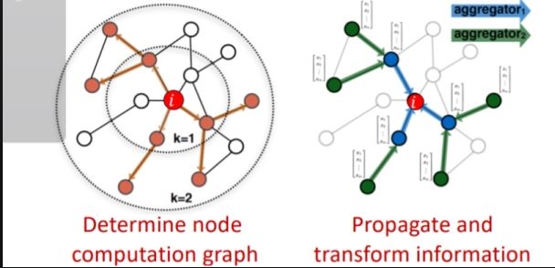
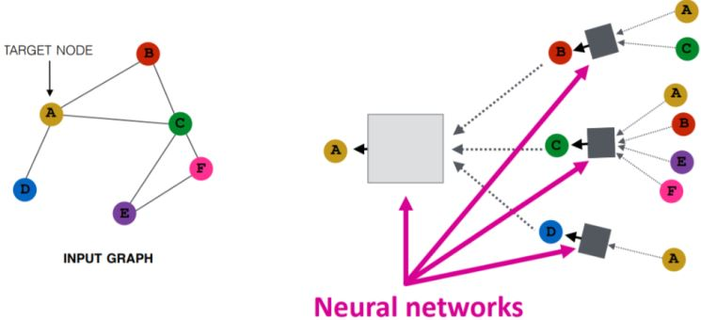
GNN
Locality information can be achieved by using a computational graph. As shown in the graph to the right, i is the red node where we see how this node is connected to its neighbors and those neighbors’ neighbors. We’ll see all the possible connections, and form a computation graph.
Once the locality information preserves the computational graph, we start aggregating. This is basically done using neural networks.
Neural Networks are presented in grey boxes. They require aggregations to be order-invariant, like sum, average, maximum, because they are permutation-invariant functions. This property enables the aggregations to be performed.

Slide 11
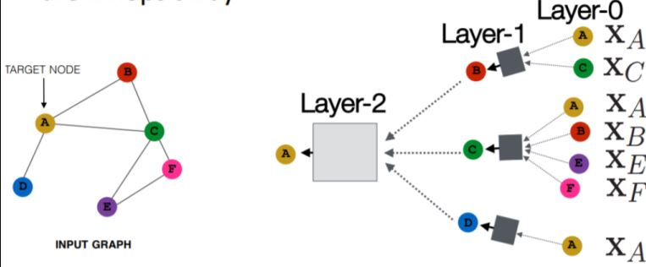
GNN
Let’s move on to the forward propagation rule in GNNs. It determines how the information from the input will go to the output side of the neural network.
Every node has a feature vector.
For example, (X_{A}) is a feature vector of node A.
The inputs are those feature vectors, and the box will take the two feature vectors (X_{A} and X_{C}), aggregate them, and then pass on to the next layer.
Notice that, for example, the input at node C are the features of node C, but the representation of node C in layer 1 will be a hidden, latent representation of the node, and in layer 2 it’ll be another latent representation.

Slide 12




GNN
So in order to perform forward propagation in this computational graph, we need 3 steps:
Initialize the activation units:
Every layer in the network:
We can notice that there are two parts for this equation:
The first part is basically averaging all the neighbors of node v.
ii. The second part is the previous layer embedding of node v multiplied with a bias Bk, which is a trainable weight matrix and it’s basically a self-loop activation for node v.
iii. σ: the non-linearity activation that is performed on the two parts.

Slide 13

GNN
3. The last equation (at the final layer):
It’s the embedding after K layers of neighborhood aggregation.
Now, to train the model we need to define a loss function on the embeddings.
We can feed the embeddings into any loss function and run stochastic gradient descent to train the weight parameters.
Training can be unsupervised or supervised:
Unsupervised training:
Use only the graph structure: similar nodes have similar embeddings. Unsupervised loss function can be a loss based on node proximity in the graph, or random walks.
Supervised training:
Train model for a supervised task like node classification, normal or anomalous node.

Slide 14
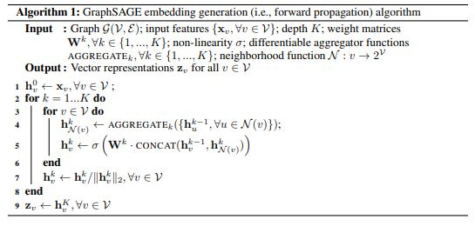
GraphSage Algorithm

Slide 15
Applications Of GNN
Graph-structured data is present everywhere. The problems that GNNs resolve can be classified into these categories:
Node classification,Graph classification,Graph visualization,Link prediction,Graph clustering
For its part, biopharma company GSK maintains a knowledge graph with nearly 500 billion nodes that is used in many of its machine-language models
LinkedIn uses GNNs to make social recommendations and understand the relationships between people’s skills and their job titles
To maintain their customers’ high level of trust, Amazon Search employs GNNs to detect malicious sellers, buyers and products.

Slide 16
References
https://neptune.ai/blog/graph-neural-network-and-some-of-gnn-applications
https://youtu.be/7JELX6DiUxQ
https://snap-stanford.github.io/cs224w-notes/machine-learning-with-networks/node-representation-learning
https://colab.research.google.com/drive/17eRoYIBxlgxAMKHV4qmXmBYL2-Wkl3Xx?usp=sharing
https://blogs.nvidia.com/blog/2022/10/24/what-are-graph-neural-networks/

